Slide 1
Programme:
Session 1
Short introduction to Mizer – what is it? What can it do? How is it constructed?
First R notebook: setting up a Mizer model with “manual” calibration
Hands-on in groups
Q&A
Session 2
5) Second R notebook: ”automatic” calibration; more detailed calibration
6) Hands-on in groups
7) Q&A
Session 3 (in two weeks)
8) Presentation of own work
9) Q&A
10) Feedback to us!
We need your feedback
Notes:
The material we present is in development. There will be issues! Please bear with us and help us improve with feedback.
Full agenda:
Agenda
1. Welcome presentation of us
2. Introduce program (breakout rooms later)
3. Powerpoint 20 min
4. Self study markdown in the breakout rooms: (15-20 min)
instructions:
-> introduce yourselves
-> https://sizespectrum.org/mizerHowTo/
-> [ install.package(“devtools”) ]
-> library(“devtools”)
-> devtools::install_github("sizespectrum/mizerHowTo")
-> library(“mizerHowTo”);
-> tutorial(“HTM1”).
-> run until step 3; try to copy the commands into R
->> call us if you have problems or if you are through
5. shiny parameters (10 min)
6. Introduction to step 3 (10 min)
7. Work on step 3+4 (20 min)
8. Meet-up; Q&A
——
Day #2
1. Welcome back. New questions? 10 min
2. Go through each of the steps + plenum (15 min pr step)
3. make your own model 30 min
4. plenum discussion 10 min
5. evaluation => fill out the form + plenum. 10 min

Slide 2
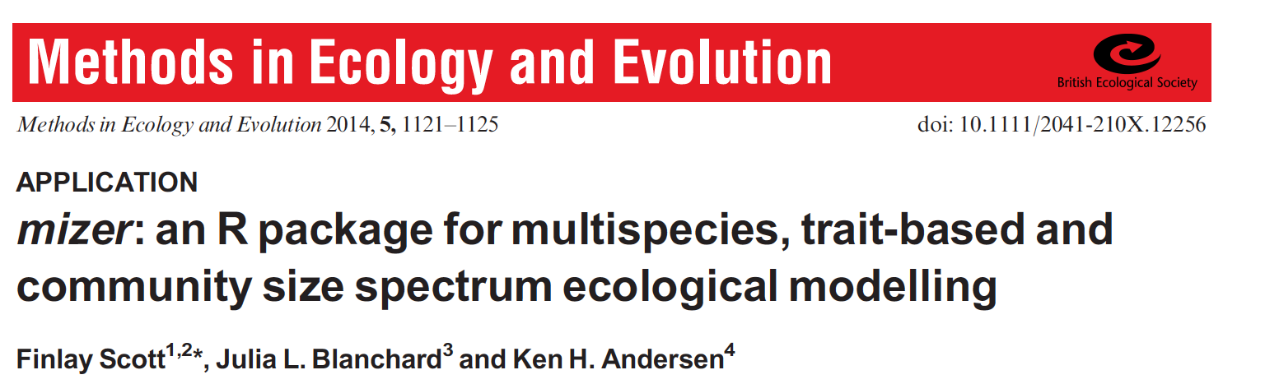
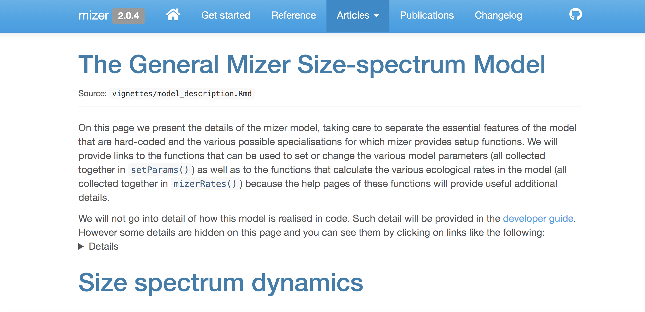
- a tool for running dynamic size spectrum models
https://sizespectrum.org/mizer/

Slide 3

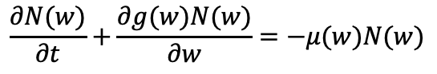
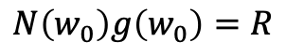
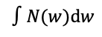
What is a “size spectrum”?
Divide by size range
Multiply by weight
Histogram
Number spectrum
Biomass spectrum
Numbers
Numbers/weight
Biomass/weight
Weight
$$∫N(w)dw$$
Divide by weight
Growth
Mortality
McKendric von Foerster equation:
$$\frac{∂N(w)}{∂t}+\frac{∂g(w)N(w)}{∂w}=−μ(w)N(w)$$
Recruitment:
$$N\left(w_{0}\right)g\left(w_{0}\right)=R$$
Recruitment
Notes:
The aim of Mizer is to calculate the ”Size spectrum” of fish.
What is a size spectrum? There are (at least) three representations. Mizer uses the number spectrum internally
How does Mizer calculate the size spectrum? By solving MvF from: growth, mortality, and recruitment

Slide 4

Three principles
1) Individual – level physiology
Asymptotic size as master trait, with additional parameters specified if available
2) Interactions between individuals
Size-based prey selection, with species-based selection specified if known
Charlie Harper
Stock-recruitment relation, used to calibrate species biomass and recruitment
3) Stock-level recruitment

Slide 5
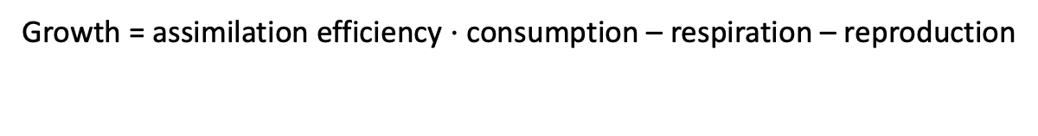
Individual physiology
Growth = assimilation efficiency $⋅$ consumption – respiration – reproduction
reproduction, w¹
W∞
Log(mass/time)
weight
consumption w^{3/4}
Log(weight)
age
W∞
Maximum size

Slide 6
Von Bertalanffy vs physiology
Weight
A*w^{0.75}
w_inf
0.01*Linf^3
w_mat
1/k_vb
Age

Slide 7
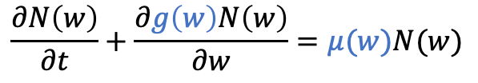
Food
numbers, N
Resource (zooplankton)
Predation μ
N
Growth g
Size w
Stock-recruitment relation
$$\frac{∂N\left(w\right)}{∂t}+\frac{∂g\left(w\right)N\left(w\right)}{∂w}=μ(w)N(w)$$
Notes:
Dynamic growth and mortality

Slide 8
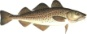

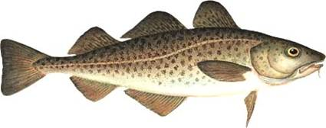
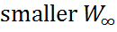
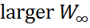
Single species perspective
…
Abundance
R
log(w)
w
0
R_{p}
W
∞
BH Recruitment
Notes:
Single stock if growth and mortality is fixed

Slide 9
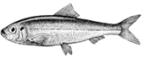
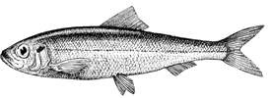
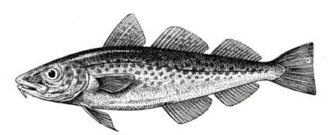
Dynamic model
10
0
Plankton
10
-1
10
-2
10
-3
10
-4
Fish
Biomass density
10
-5
10
-6
10
-7
10
-8
10
-9
10
-10
0.1 g
10 g
1 kg
100 kg
Individual weight
Andersen and Pedersen, Proc. Roy. Soc. London B (2010)

Slide 10
Response to fishing
10
0
Plankton
10
-1
10
-2
10
-3
10
-4
Fish
Numbers
-5
Fishing
10
10
-6
10
-7
10
-8
10
-9
10
-10
0.1 g
10 g
1 kg
100 kg
Individual weight
Andersen and Pedersen, Proc. Roy. Soc. London B (2010)
Notes:
Putting it together and fishing

Slide 11
Closer look at parameters
Food encounter & consumption
Food selection
Growth & reproduction
Recruitment
Mortality

Slide 12
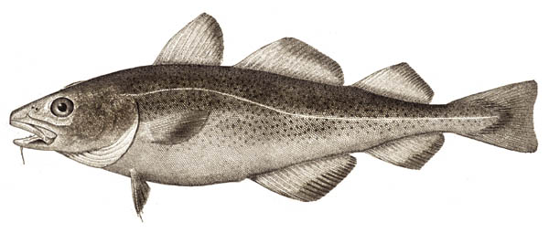
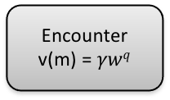
Encounter
v(m) = $γwq$
search volume ∝ γ⋅w^{q}

Slide 13
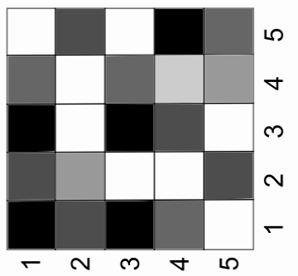
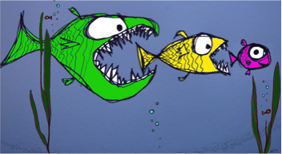
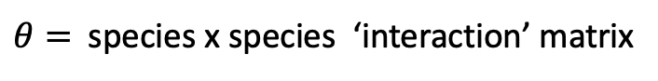
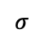
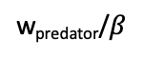
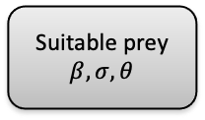
Suitable prey
$$β,σ,θ$$
$θ=$species x species ‘interaction’ matrix
Probability of eating encountered prey
Predator species
$$σ$$
Prey species
w_{predator}/$β$
w_{predator}
Individual body weight w
Notes:
We showed the size-selective feeding traits in the model affect the stability of the size spectrum.
This is the prey size distribution for a given size predator.
On a log scale , the difference between the size of a predator and the size of its prey is calledt he predator-prey mass ratio.
When the difference by the mean size of prey and the size of predator is small and when the standard deviation of this distribution is large it leads to stable steady-state size spectra.

Slide 14
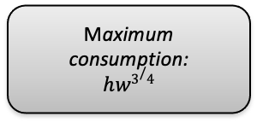
Maximum consumption:
$$hw3/4$$
Maximum
consumption
Type II functional response
Encountered food

Slide 15
Growth
Growth = α⋅consumption - standard metabolism – reproduction
weight
(kg)
Asymptotic size W∞
10
8
6
4
2
Time
(year)
0
10
20
30

Slide 16
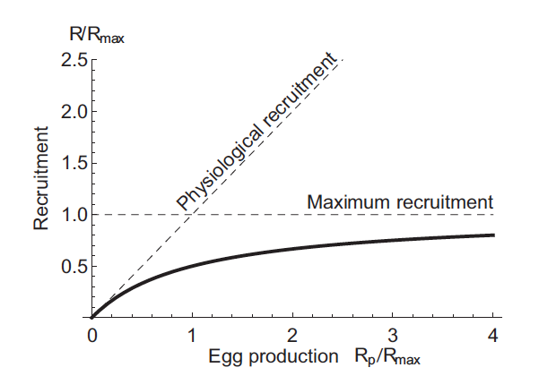
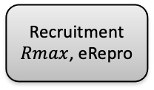
Recruitment
$Rmax$, eRepro
= reproduction * eRepro
Rmax

Slide 17
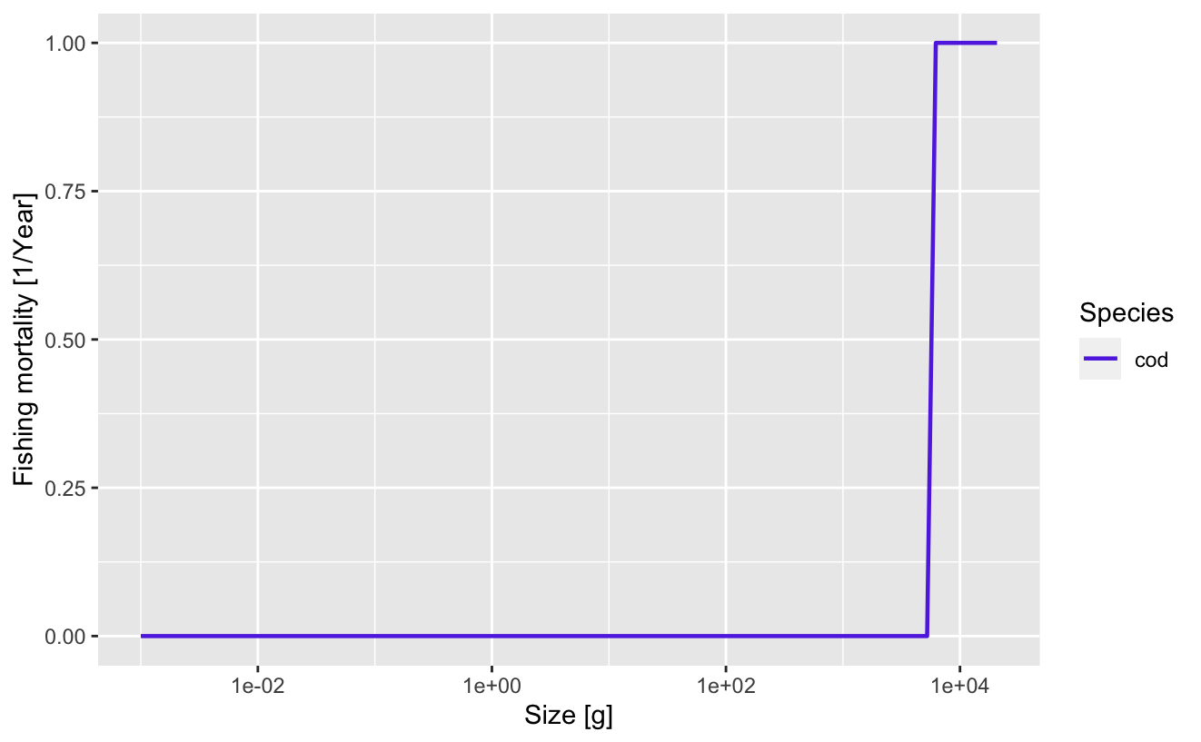
Mortality
Four types of mortality:
Predation mortality (emerges from food dependent interactions)
Size-selective and species-specific fishing mortality
Background other mortality
Starvation mortality
Knife-edge
Logistic “trawl”

Slide 18
Parameterisation of life history
Literature estimates
Can start off with Winf-estimates from Fishbase (often need to convert from length)
Directly observed data estimates
Best to collect ranges of these, to enable sensitivity testing or uncertainty (priors)

Slide 19
Calibration
Need observations of biomass
If fished system, need some information on fishing mortality rate
“Tune” parameters with highest uncertainties (previous work on recruitment parameters, R_{max}, e_{Repro}) to enable model to fit data
Assess error between modelled and observed outputs (‘like with like’)
Consider observation error/biases
Tomorrow: Simple Optimization using time averaged catch data
Iterative procedure:
calibrate -> check assumptions & fit -> adjust parameters -> re-calibrate

Slide 20
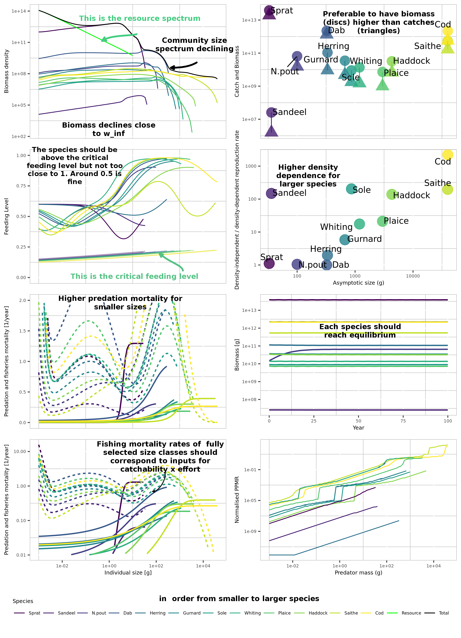
Initial Diagnostics
“feeding level” =
Consumption/max. consumption

Slide 21
What now?
https://sizespectrum.org/mizerHowTo/
[ install.package(“devtools”) ]
library(“devtools”)
devtools::install_github("sizespectrum/mizerHowTo")
library(“mizerHowTo”)
tutorial(“HTM1”)

